Slide 1
Glucose Spike Prediction from Meal Macros
An Exploratory Data Analysis
Directed Reading Program 2025, Viggy Vanchinathan
Mentor: Andrew Henrichson
Notes:
Outline:
intro slide
agenda
introduction about glucose monitors (personal story)
introductory analysis (explaining dataset, visualization of signal, healthy ranges, plotting meals, detecting peaks, explaining peaks [double peak phenomenon] )
first task (can we use meal macros to predict height of glucose spike)
user app idea
different architectures of
thanks to drp program (special thanks to drew and josiah)
Diabetes & Glucose Monitoring – introduction
CGMacros Dataset
Study methodology
Example signal
Glucose spikes
The Problem
Strategies for Prediction
??? → big guns…
???
???
Success?

Slide 2
Agenda
Diabetes & Glucose Monitoring – introduction
CGMacros Dataset
Study methodology
Example signal
Glucose spikes
The Problem
Strategies for Prediction
???
???
???
Success?

Slide 3

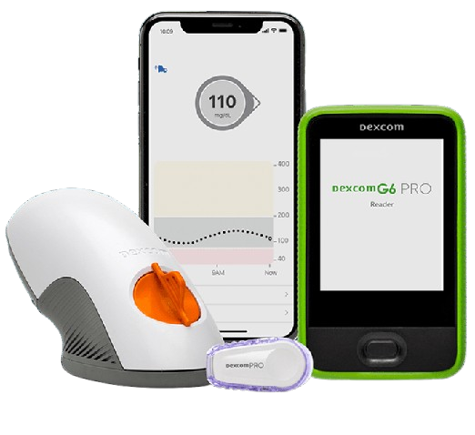
Glucose Monitoring
Abbott FreeStyle Libre Pro CGM
Dexcom G6 Pro CGM
Notes:
differe

Slide 4

CGMacros Dataset
Multimodal dataset containing: meal macronutrients, photographs of food, physical activity, patient health parameters from blood analysis, gut microbiome profiles of 45 study participants (15 healthy adults, 16 with prediabetes, 14 with type 2 diabetes)
→ Continuous glucose measurement over 10 day time span with standardized meals
Notes:
Taken from PhyisoNet
Multimodal dataset containing meal macronutrients, photographs of the food, physical activity (?), patient health parameters from blood analysis, gut microbiome profiles of 45 study participants (15 healthy adults, 16 with prediabetes, 14 with type 2 diabetes) → continuous glucose metrics from both the glucose monitors show before, while they consumed standardized meals over 10 day time span

Slide 5
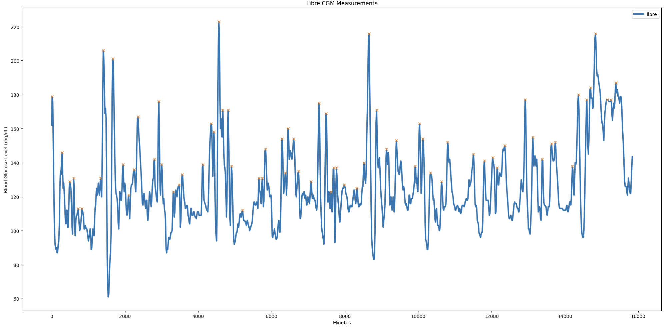
Continuous Time-Series GM
Notes:
Difference from CGM measurements due to accuracy but also different placement

Slide 6
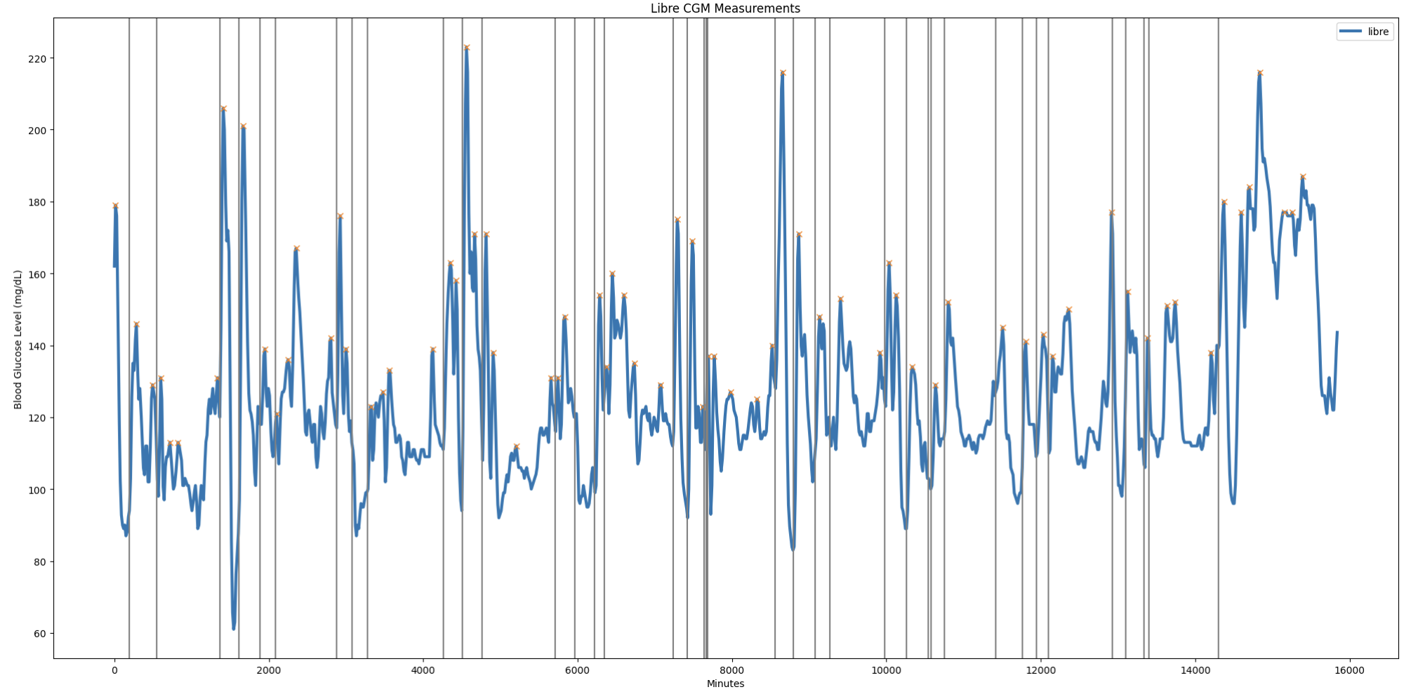
Continuous Time-Series GM
Notes:
Difference from CGM measurements due to accuracy but also different placement

Slide 7
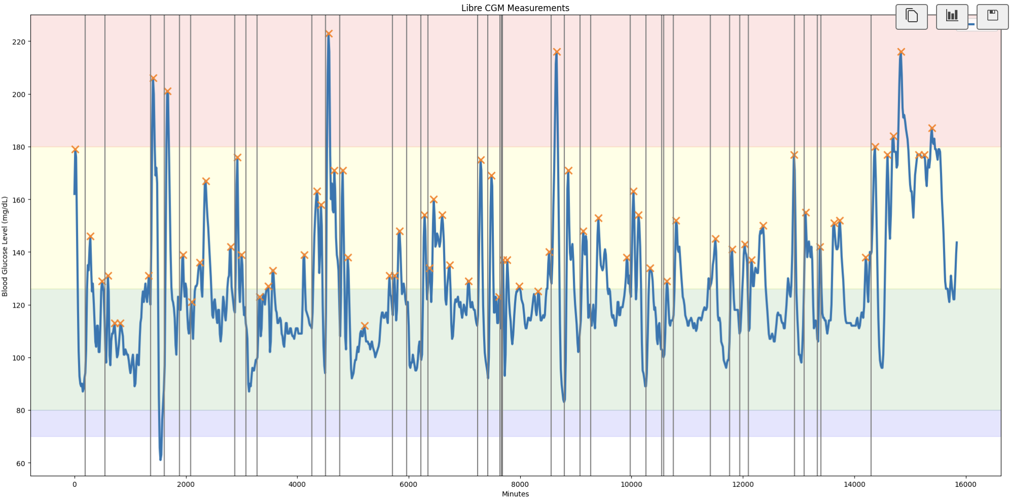
Continuous Time-Series GM
Notes:
Difference from CGM measurements due to accuracy but also different placement

Slide 8
Continuous Time-Series GM
Notes:
Difference from CGM measurements due to accuracy but also different placement

Slide 9
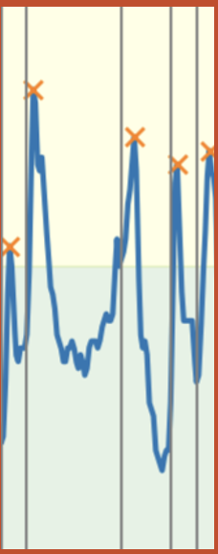
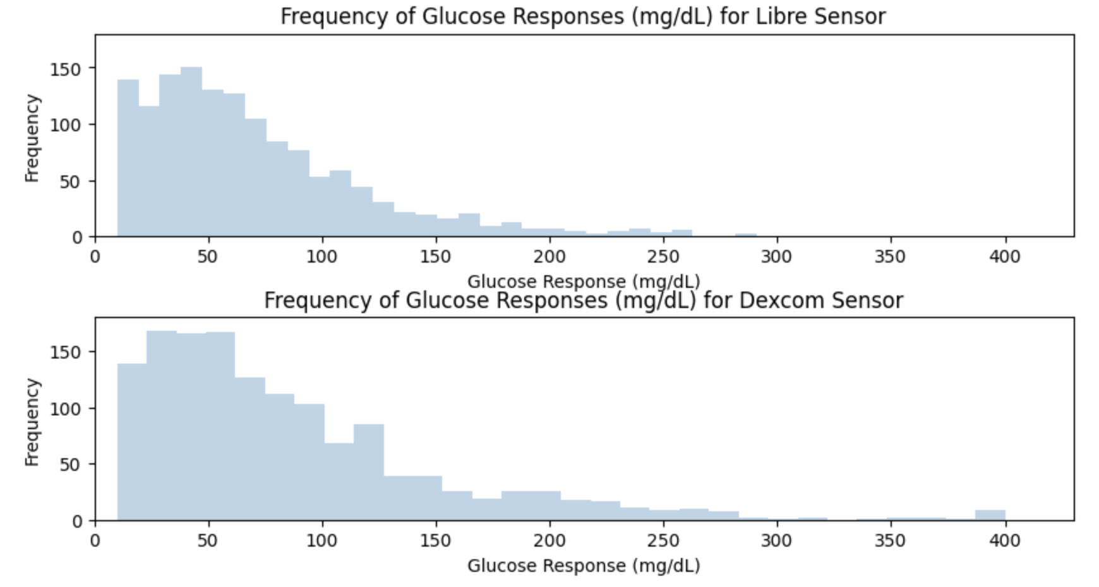
Finding Peaks
NOT the overall height of the peak!
r = 0.735
Notes:
Also include libre?
array([[1. , 0.73544797], [0.73544797, 1. ]]) strong-ish correlation between the two signals in spike detection so for this analysis choosing to focus on one of the two…

Slide 10
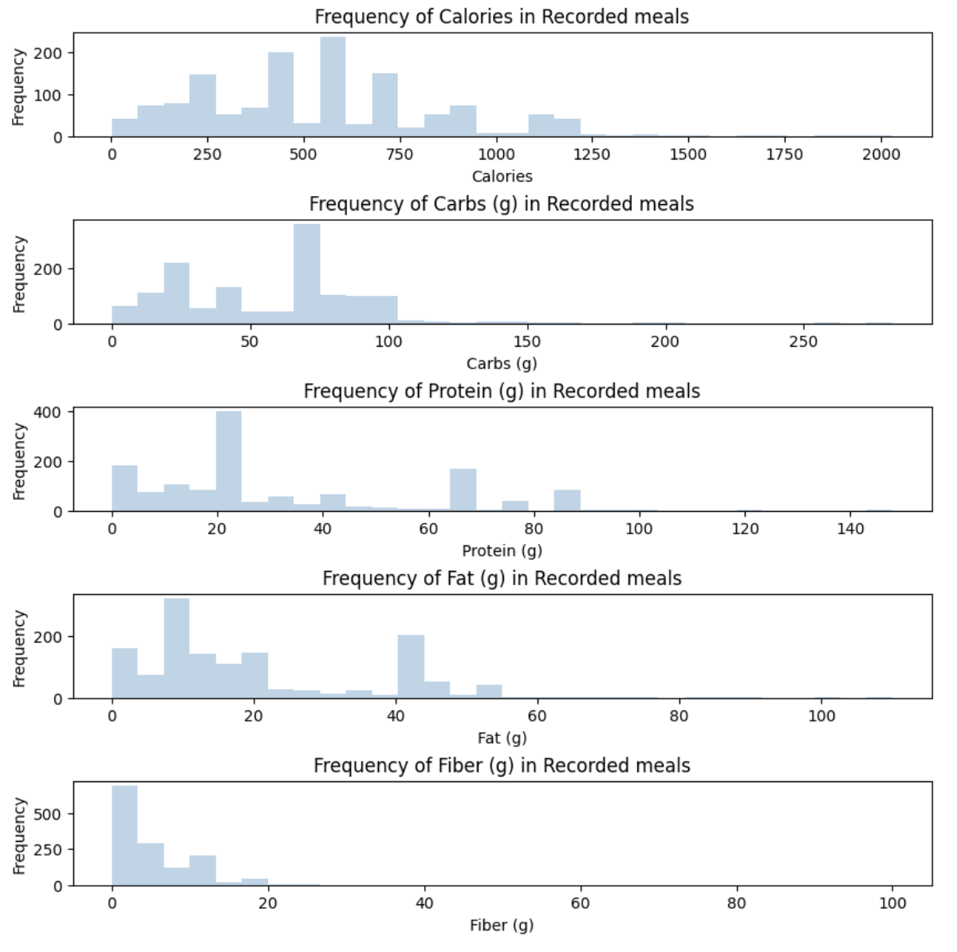
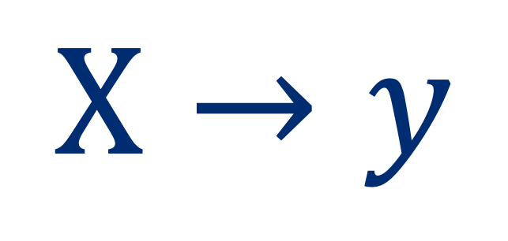
The Problem… (postprandial spike)
$$Χ→y$$
Calories, Fat, Protein, Fiber, Carbs…
Severity of glucose spike
Notes:
postprandial tachycardia
2826.0 761.0 148.0 508.0 2830.0
Obscene fat and fiber values…
(mldf["Calories"] <= 2100) &
(mldf["Carbs"] <= 400) &
(mldf["Protein"] <= 200) &
(mldf["Fat"] <= 130) &
(mldf["Fiber"] <= 120) &
(mldf["lib_prom"] > 0)

Slide 11

… the artillery!
???
???
???

Slide 12

First Pass
Linear Methods
???
???

Slide 13

Naïve Approach: Regression
$$w_{0}+ {w_{1}x}_{1}+{w_{2}x}_{2}+{w_{3}x}_{3}+{w_{4}x}_{4}+{w_{5}x}_{5}=y$$
Carbs
Protein
Fats
Fiber
Calories
Want $w$ to minimize Mean Squared Error (OLS)

Slide 14
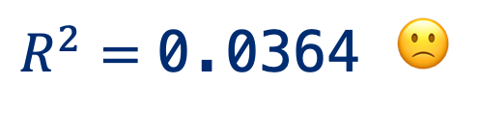
Naïve Approach: Regression
$$w_{0}+ {w_{1}x}_{1}+{w_{2}x}_{2}+{w_{3}x}_{3}+{w_{4}x}_{4}+{w_{5}x}_{5}=y$$
Carbs
Protein
Fats
Fiber
Calories
69.764 0.493 -0.074 0.024 -1.126 0.010
$$R^{2}=\text{0.036}\text{4 }🙁$$
Notes:
Coefficients: [ 9.55860159e-04 -2.08845329e-02 -1.46836000e+00 6.77579229e-01 2.49231357e-01]

Slide 15
Second Pass
Linear Methods
Nonlinear Methods
???
Notes:
Confusion matrix to show true vs predicted classes
Show ranges that count as low, medium, high in graphic

Slide 16
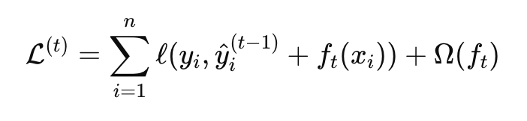
XGBoost: Gradient Boosted Decision Trees
Discretized data into three stages
<50,
50-100
>100
Hopefully easier task!
Notes:
f spike is None:
disc.append(None)
elif spike < 20:
disc.append(0)
elif spike < 50:
disc.append(1)
elif spike < 80:
disc.append(2)
elif spike < 100:
disc.append(3)
else:
disc.append(4)

Slide 17
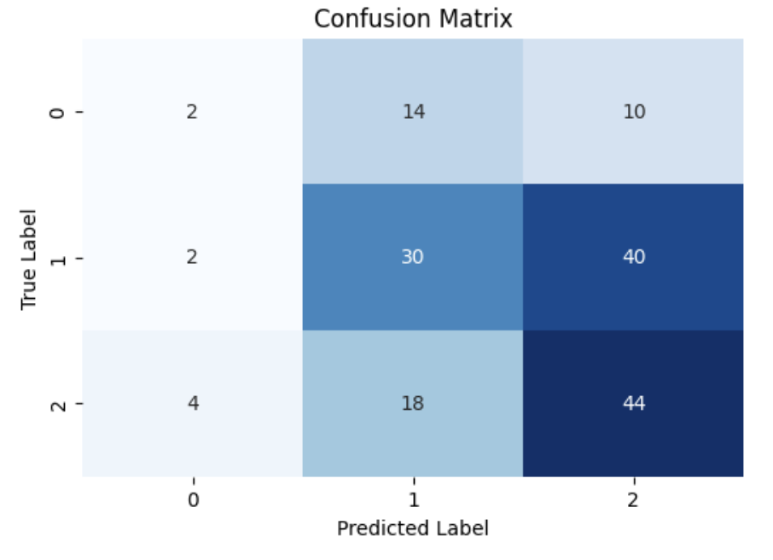
XGBoost: Gradient Boosted Decision Trees
Accuracy: 0.44

Slide 18
Third Pass
Linear Methods
Nonlinear Methods
Neural Methods

Slide 19
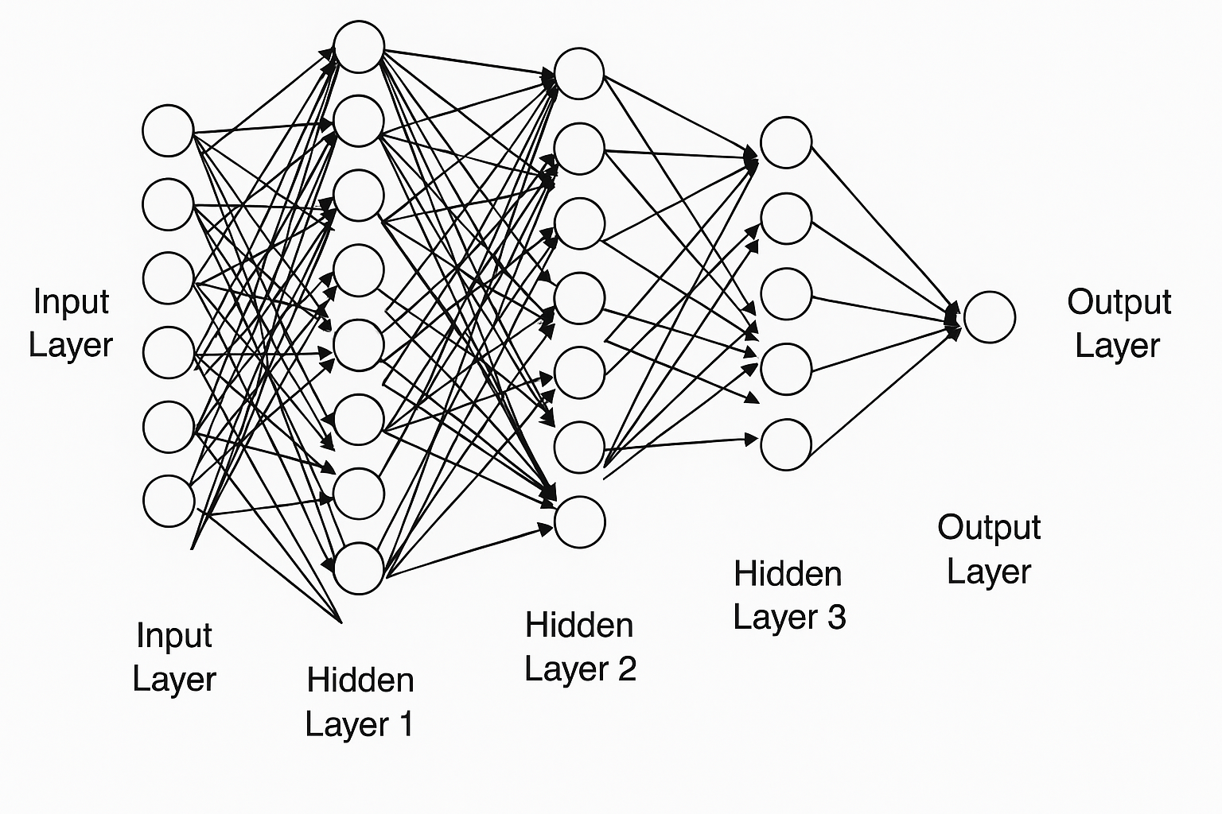
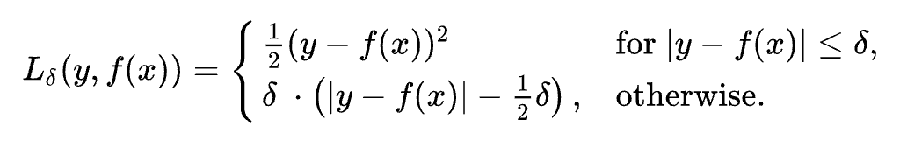
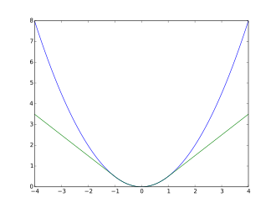

Multilayer Perceptron
Want $w^{1}, w^{2}, w^{3}$to minimize Huber Loss
Notes:
used the adam optimizer

Slide 20
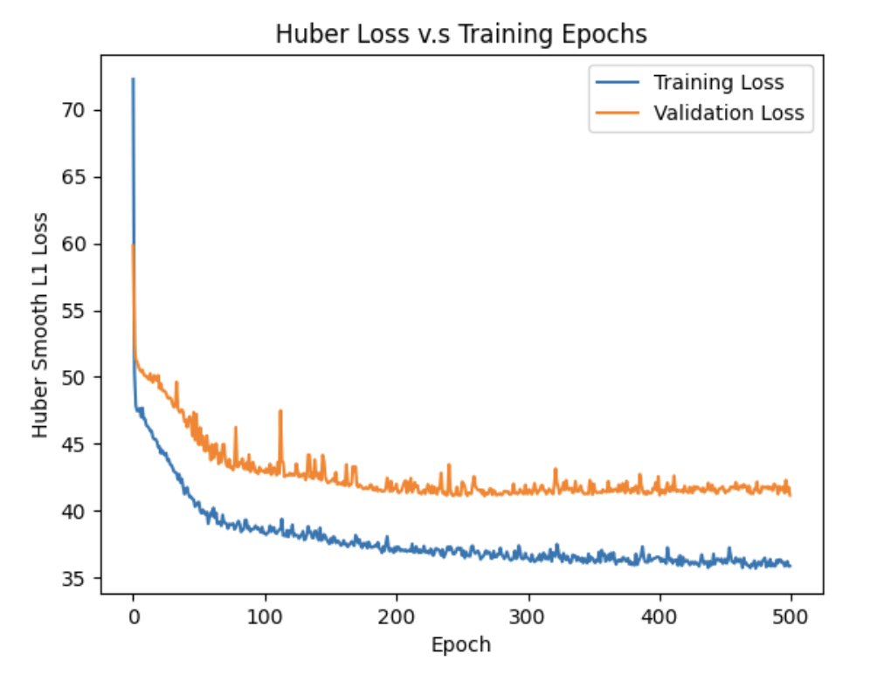
Multilayer Perceptron
Hyperparameters:
Huber Smoothed L1 Loss
Adam Optimizer
Epoch size: 500
Batch size: 64
MAE: 38.46 mg/dL

Slide 21
Conclusions & Future Directions
Conclusions
Glucose response is highly dependent on the participant response characteristics, sensitivity
Nonlinear dynamics between macronutrient composition and glucose spike value
Limitations due to confounding effect of unspecified variables (e.g. insulin amount)
Extension
Incorporating multimodal analysis:
Meals pictures/consumption -> macro estimation -> glucose spike prediction (famous use case)
Time/Sequence dependent models (LSTM, HMM)
More mechanistic models (dependent on glucose response modeling)

Slide 22

???

